Slide 1
BATTLE OF CITY LONDON AND PARIS

Slide 2
Introduction
London and Paris are quite the popular tourist and vacation destinations for people all around the world. They are diverse and multicultural and offer a wide variety of experiences that is widely sought after.
We try to group the neighbourhoods of London and Paris respectively and draw insights to what they look like now.
BUSINESS PROBLEM
The aim is to help tourists choose their destinations depending on the experiences that the neighbourhoods have to offer and what they would want to have.
This also helps people make decisions if they are thinking about migrating to London or Paris or even if they want to relocate neighbourhoods within the city.

Slide 3
DATA SOURCE
LONDON DATA
To derive our solution, We scrape our data from https://en.wikipedia.org/wiki/List_of_areas_of_London
This wikipedia page has information about all the neighbourhoods, we limit it London.
1. borough : Name of Neighbourhood
2. town : Name of borough
3. post_code : Postal codes for London.
PARIS DATA
To derive our solution, We leverage JSON data available at https://www.data.gouv.fr/fr/datasets/r/e88c6fda-1d09-42a0-a069-606d3259114e
The JSON file has data about all the neighbourhoods in France, we limit it to Paris.
1. postal_code : Postal codes for France
2. nom_comm : Name of Neighbourhoods in France
3. nom_dept : Name of the boroughs, equivalent to towns in France
4. geo_point_2d : Tuple containing the latitude and longitude of the Neighbourhoods.

Slide 4
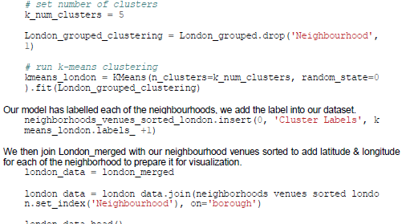
MODEL BUILDING
We use Kmeans Clustering Machine learning algorighm
We are going with 5 number of clusters

Slide 5
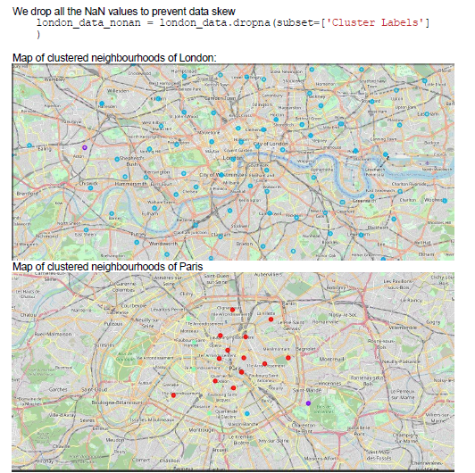
Visualizing Clustered Neighbourhoods
Our data is processed, missing data is collected and compiled. The Model is built. All that's remaining is to see the clustered neighbourhoods on the map. Again, we use Folium package to do so.

Slide 6
Results
LONDON
The neighbourhoods of London are very mulitcultural. There are a lot of different cusines including Indian, Italian, Turkish and Chinese. London seems to take a step further in this direction by having a lot of Restaurants, bars, juice bars, coffee shops, Fish and Chips shop and Breakfast spots. It has a lot of shopping options too with that of the Flea markets, flower shops, fish markets, Fishing stores, clothing stores. The main modes of transport seem to be Buses and trains. For leisure, the neighbourhoods are set up to have lots of parks, golf courses, zoo, gyms and Historic sites. Overall, the city of London offers a multicultural, diverse and certainly an entertaining experience.
PARIS
Paris is relatively small in size geographically. It has a wide variety of cusines and eateries including French, Thai, Cambodian, Asian, Chinese etc. There are a lot of hangout spots including many Restaurants and Bars. Paris has a lot of Bistro's. Different means of public transport in Paris which includes buses, bikes, boats or ferries. For leisure and sight seeing, there are a lot of Plazas, Trails, Parks, Historic sites, clothing shops, Art galleries and Museums. Overall, Paris seems like the relaxing vacation spot with a mix of lakes, historic spots and a wide variety of cusines to try out.

Slide 7
Conclusion
Both Paris and London seem to offer a vacation stay or a romantic getaway with a lot of places to explore, beautiful landscapes, amazing food and a wide variety of culture. Overall, it's upto the stakeholders to decide which experience they would prefer more and which would more to their liking.

Slide 8
THANK YOU

